Slide 1
COMP 51 Week Eight
Arrays
Debugging Techniques

Slide 2
Learning Objectives
Complex Data – Intro to Arrays
More Details on Debugging and Testing programs
Multidimensional Arrays.

Slide 3
Why Do We Care?
Debugging tools make your life easier!
Complex programs require complex data structures.
Many programs require searching and sorting data lists.

Slide 4
Introduction to Arrays
Array definition:
A collection of data of same type
First "aggregate" data type structure
Means "grouping"
int, float, double, char are simple data types
Declaration
int score[4];
Cell
0
Cell
1
Cell
2
Cell
3
Array elements
Notes:
Used for lists of like items
Test scores, temperatures, names, etc.
Avoids declaring multiple simple variables
Can manipulate "list" as one entity
Similar to declaring four variables: int score[0], score[1], score[2], score[3]

Slide 5
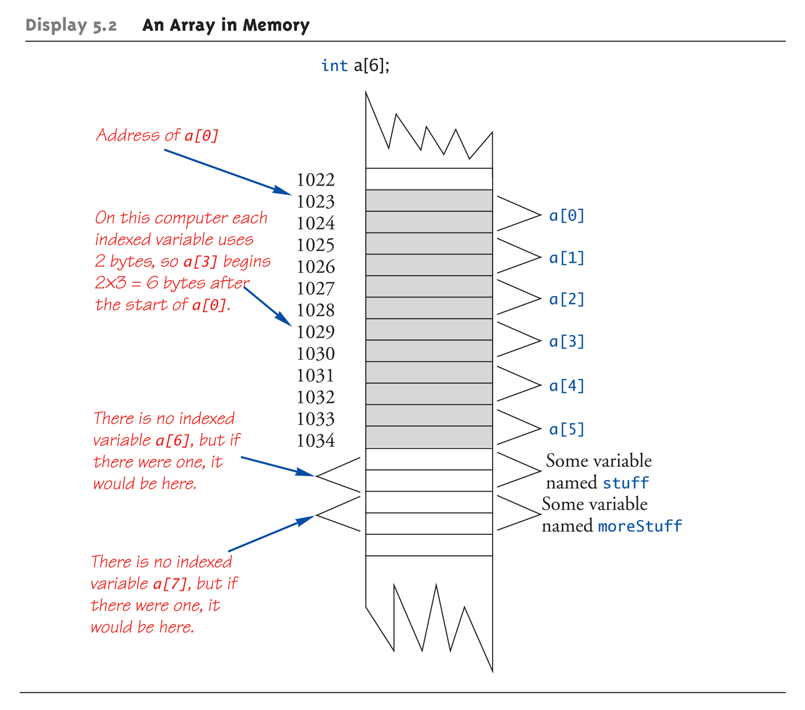
An Array in Memory
Notes:
Array declarations allocate memory for entire array
Sequentially-allocated
Means addresses allocated "back-to-back"
Allows indexing calculations
Simple "addition" from array beginning (index 0)

Slide 6
Accessing Arrays
Access using index/subscript
cout << score[3];
Note two uses of brackets:
In declaration, specifies SIZE of array
Anywhere else, specifies a subscript
Size, subscript need not be literal
int score[MAX_SCORES];
score[n+1] = 99;
If n is 2, identical to: score[3]

Slide 7
Array Usage
Solve problems like:
"Do this to i^{th} indexed variable" where i is computed by program
"Display all elements of array score"
"Fill elements of array score from user input"
"Find highest value in array score"
"Find lowest value in array score"

Slide 8
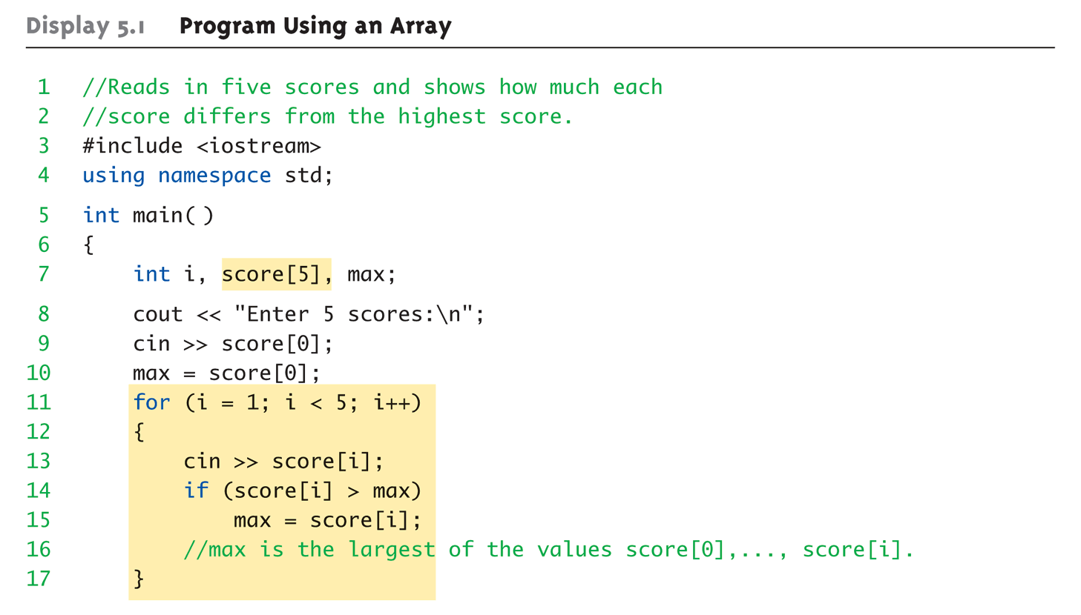
Array Program Example: 1 of 2
What would be a better way to write this code so that loop starts at zero?

Slide 9
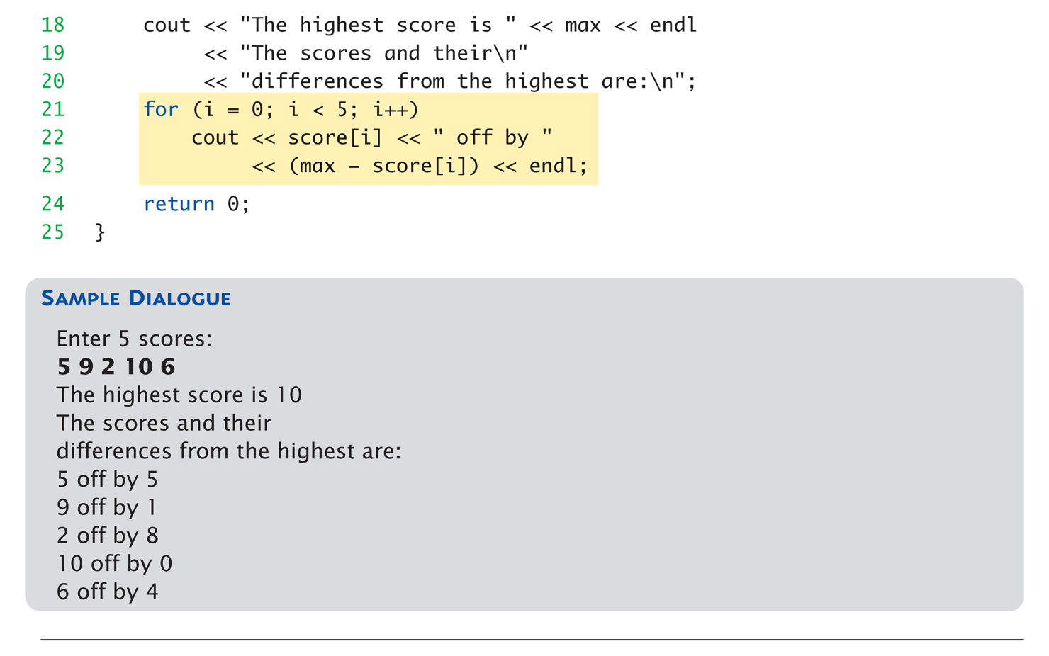
Array Program Example: 2 of 2
For loops and arrays are meant to be together → natural counting format

Slide 10
Array Indexing Pitfall
Indexes range from 0 to (array_size – 1)
Example: double temperature[24]; // 24 is array size // Declares array of 24 double values called temperature
They are indexed as: temperature[0], temperature[1] … temperature[23]
Common mistake: temperature[24] = 5;
Index 24 is "out of range"!
No warning, possibly disastrous results
Double current = temperature[i*5];
Calculation has higher precedence
Notes:
Perfectly legal, from compiler’s view
Programmer responsible for staying "in-bounds" of array

Slide 11
Use Constant as Array Size Example
Only need to change class size once
#include <iostream> const int NUMBER_OF_STUDENTS = 5;
Int main() {
int score[NUMBER_OF_STUDENTS];
for (idx = 0; idx < NUMBER_OF_STUDENTS; idx++) { // Manipulate array } lastIndex = (NUMBER_OF_STUDENTS – 1);
}
Notes:
Improves readability
Improves versatility
Improves maintainability

Slide 12
Initializing Arrays
int children[3] = {2, 12, 1};
Equivalent to following: int children[3]; children[0] = 2; children[1] = 12; children[2] = 1;
If fewer values than size supplied:
Fills from beginning
Fills "rest" with zero of array base type
If array-size is left out
Declares array with size required based on number of initialization values
Example: int b[] = {5, 12, 11};
Allocates array b to size 3

Slide 13
Arrays in Functions
As arguments to functions
As a simple variable. Ex - func1(iArray[i]);
Entire arrays. Ex – func2(iArray, MAXSIZE);
Note – Send the size of array as second argument

Slide 14
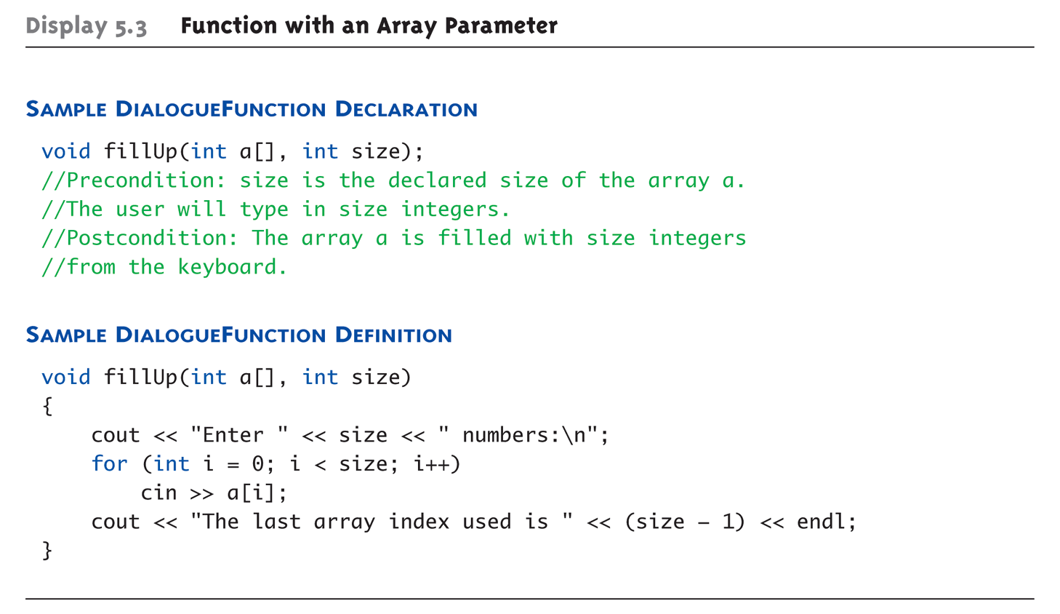
Entire Array as Argument Example
Sample Call :
int score[5], numberOfScores = 5; fillup(score, numberOfScores);
Note – No Brackets in call
fillUp is example of a generic function that fill any size array

Slide 15
Array as Argument: How?
What’s really passed?
Think of array as 3 "pieces"
Address of first indexed variable (arrName[0])
Array base type
Size of array
Only 1st piece is passed!
Just the beginning address of array
Very similar to "pass-by-reference"
Array protection
Sometimes don’t want to allow changes to array
Use const modifier
Ex - void outputdata( const studentList [], int n)

Slide 16
Partially-filled Arrays Golf Score Calculation Example
Difficult to know exact array size needed
Must declare to be largest possible size
Must then keep "track" of valid data in array
Additional "tracking" variable needed
int numberUsed;
Tracks current number of elements in array

Slide 17
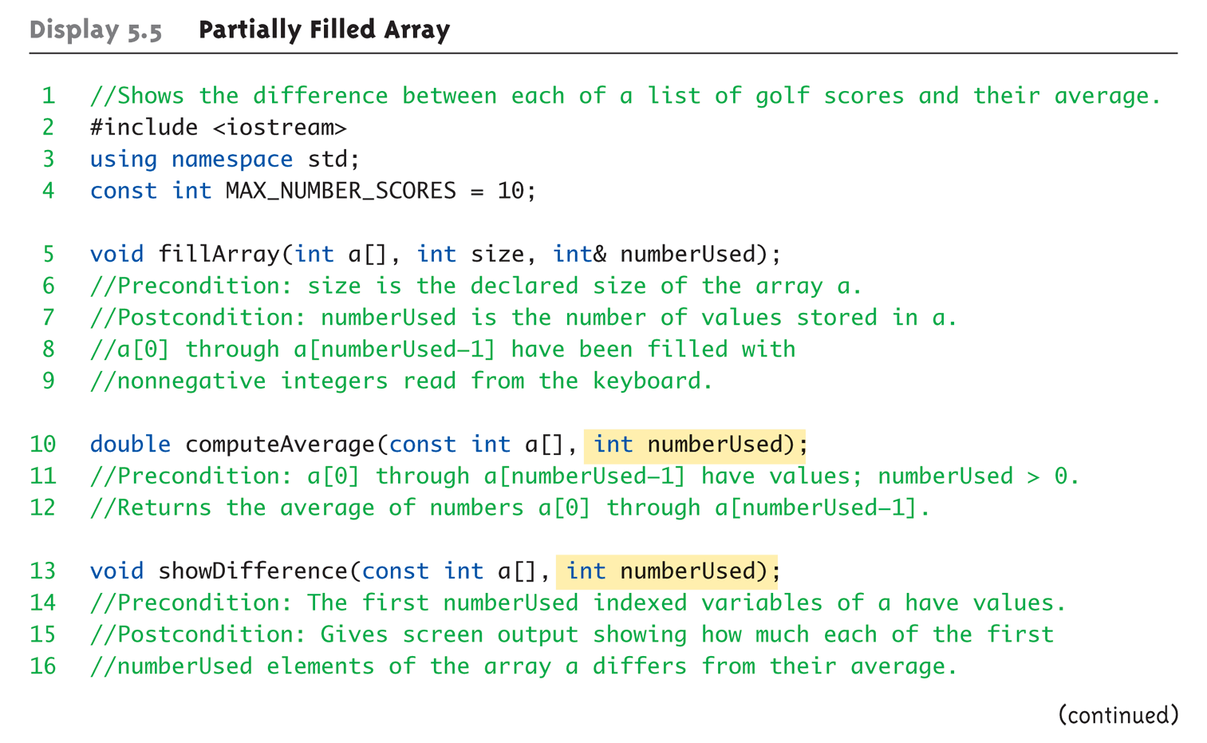
Partially-filled Arrays Example: 1 of 5

Slide 18
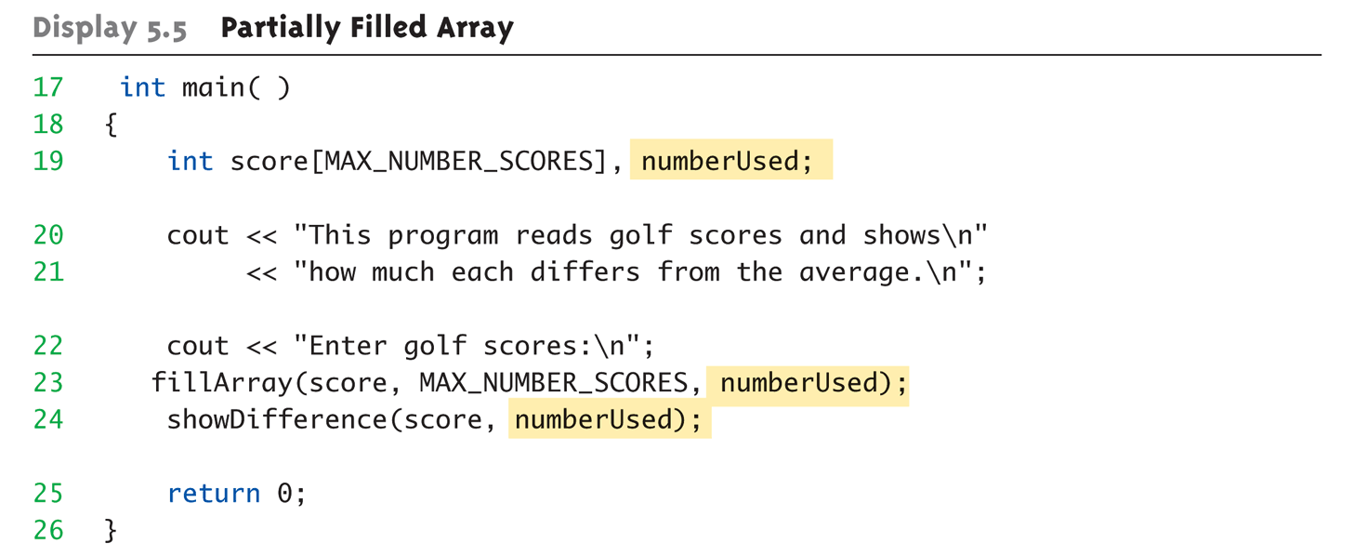
Partially-filled Arrays Example: 2 of 5

Slide 19
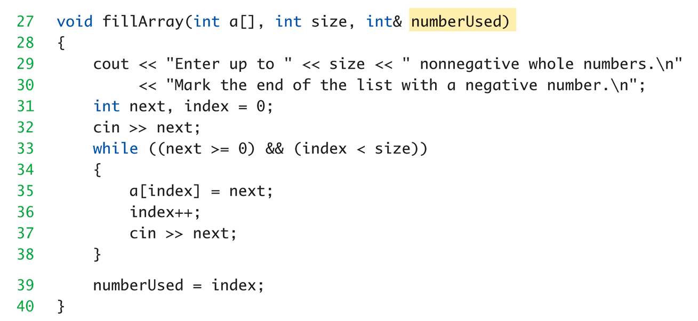
Partially-filled Arrays Example: 3 of 5

Slide 20
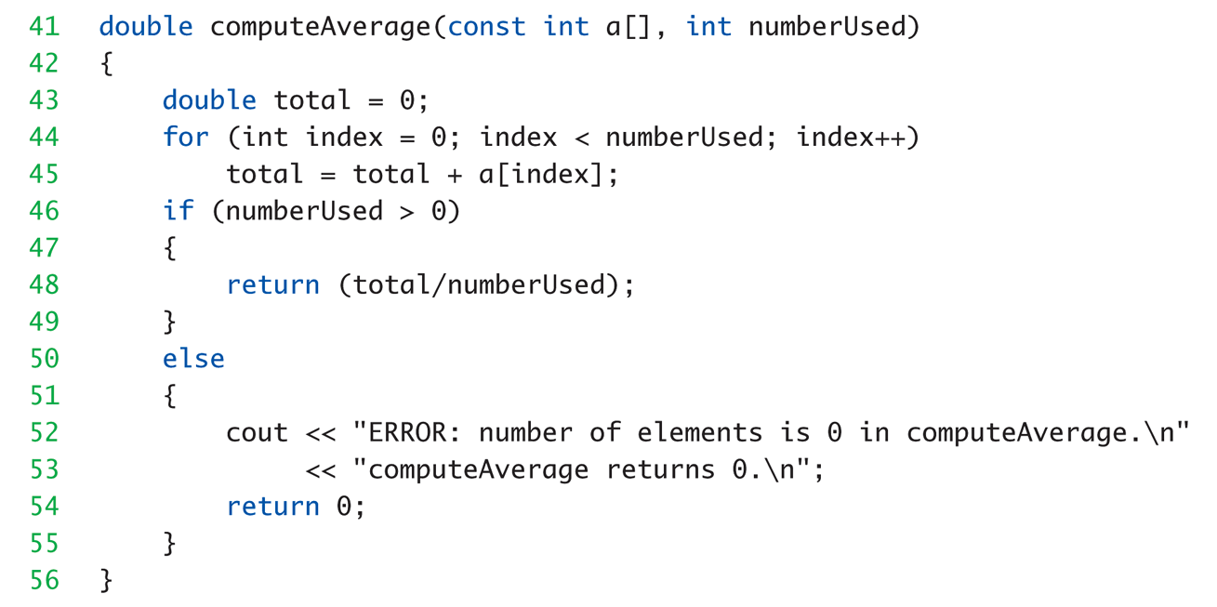
Partially-filled Arrays Example: 4 of 5

Slide 21
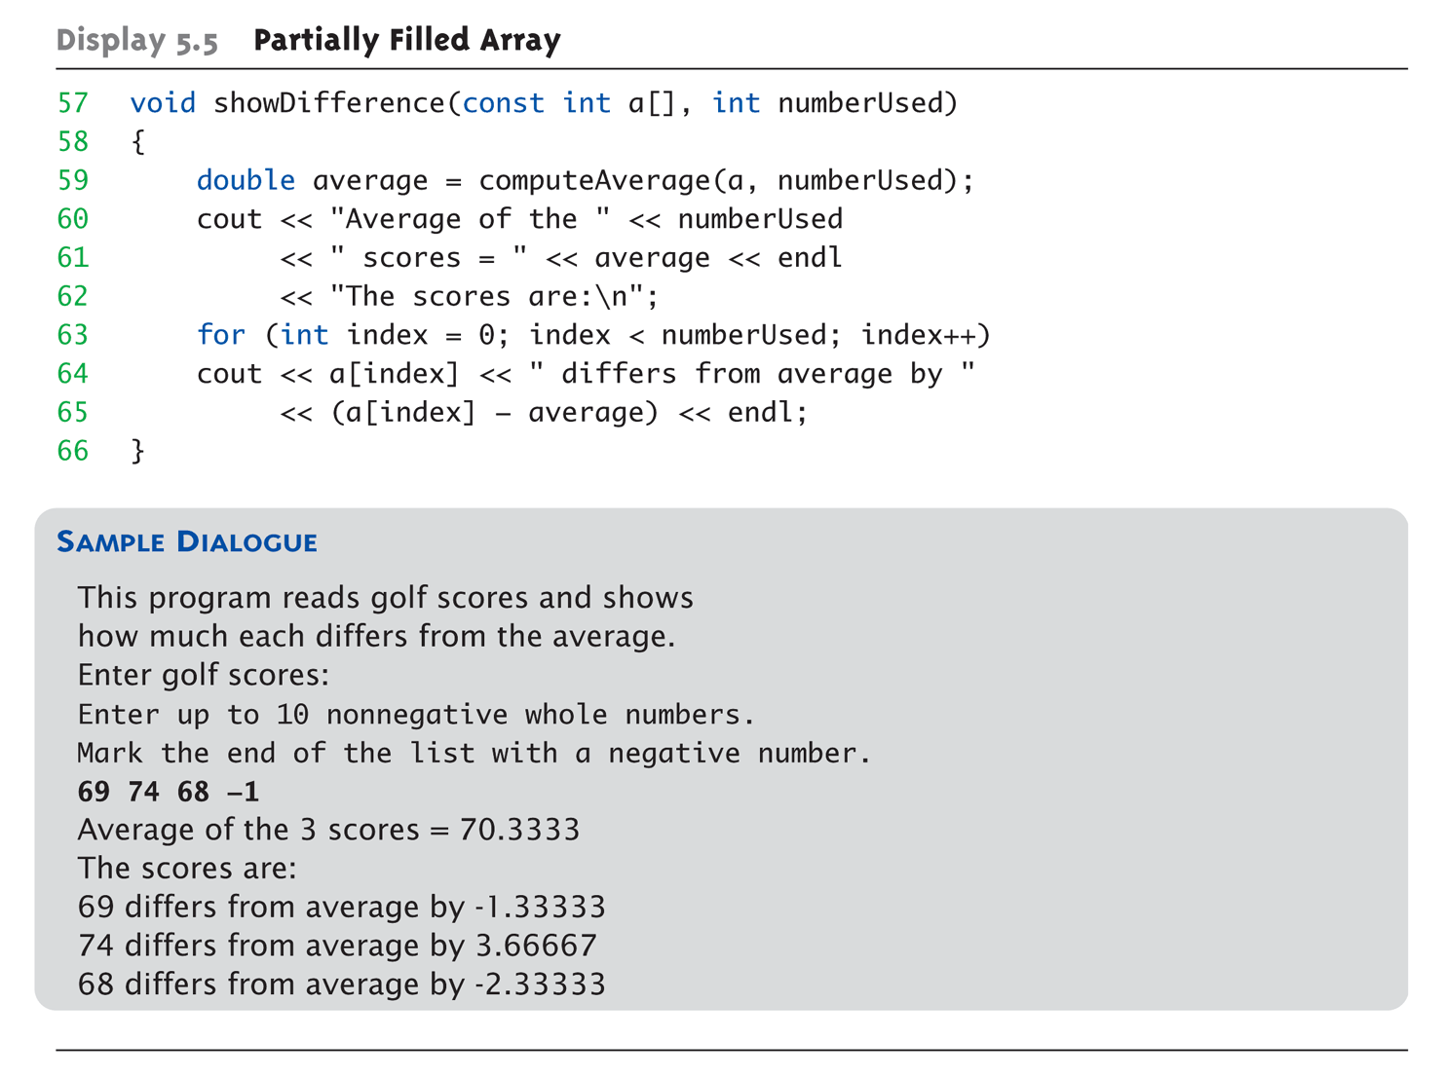
Partially-filled Arrays Example: 5 of 5
This function calls another function

Slide 22
Arrays and Functions Practice
Write a function that will truncate all floating point numbers in the array. The results will be saved in a different array.
It has three parameters
Source array of double values
Target array of double values
Size of the array
There is no return value.
Hint – Look for the appropriate math function in previous slides

Slide 23
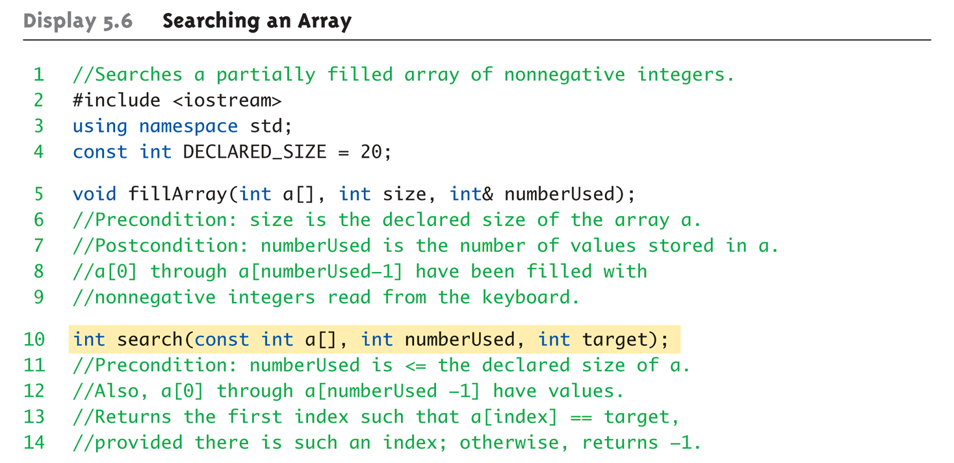
Searching an Array (1 of 4)

Slide 24
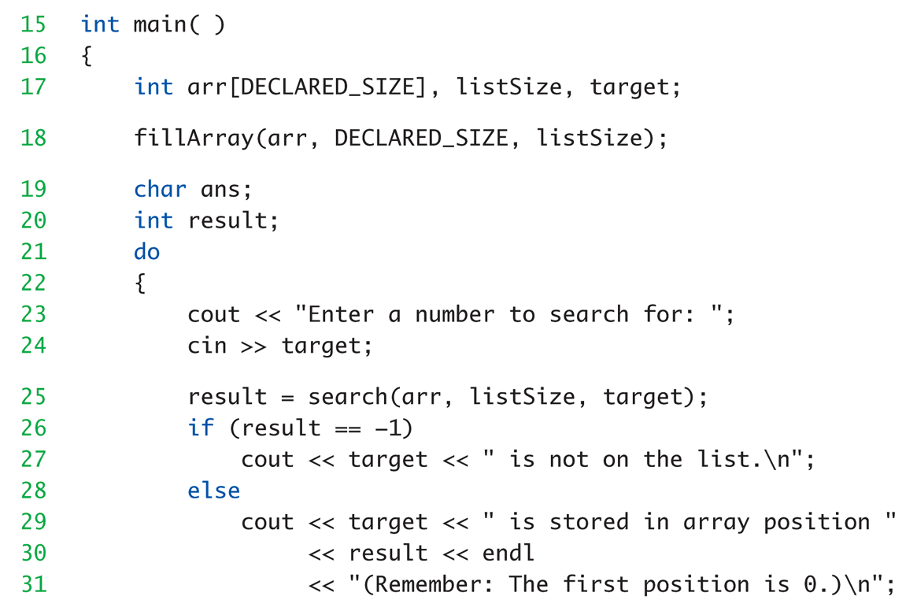
Searching an Array (2 of 4)

Slide 25
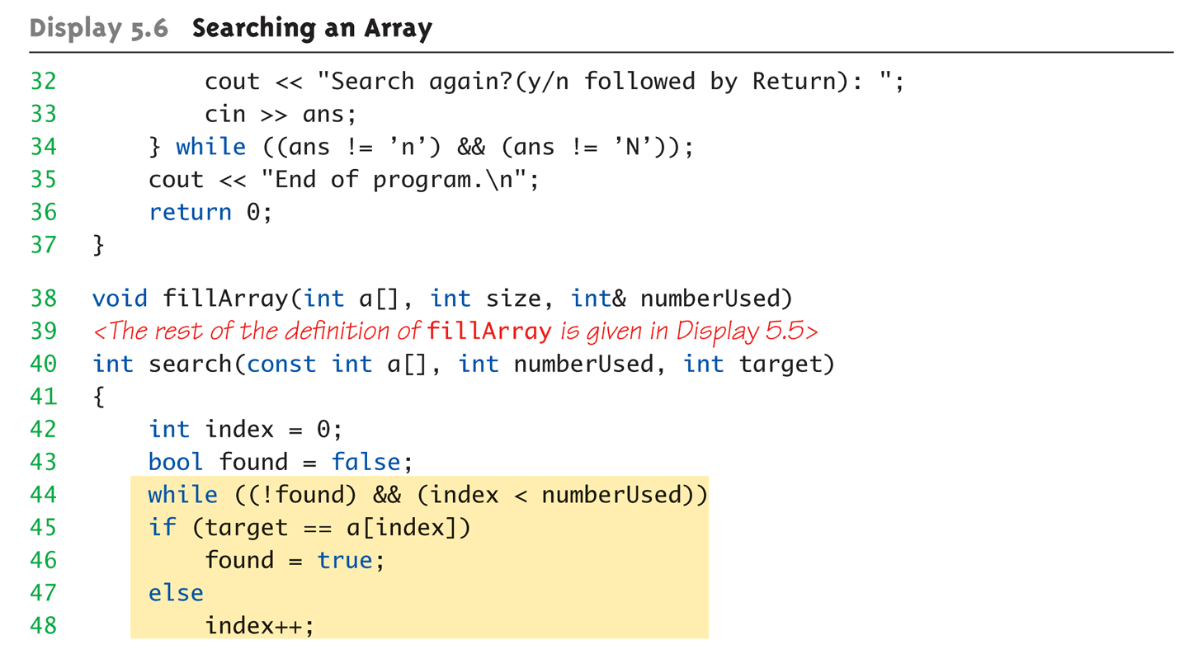
Searching an Array (3 of 4)

Slide 26
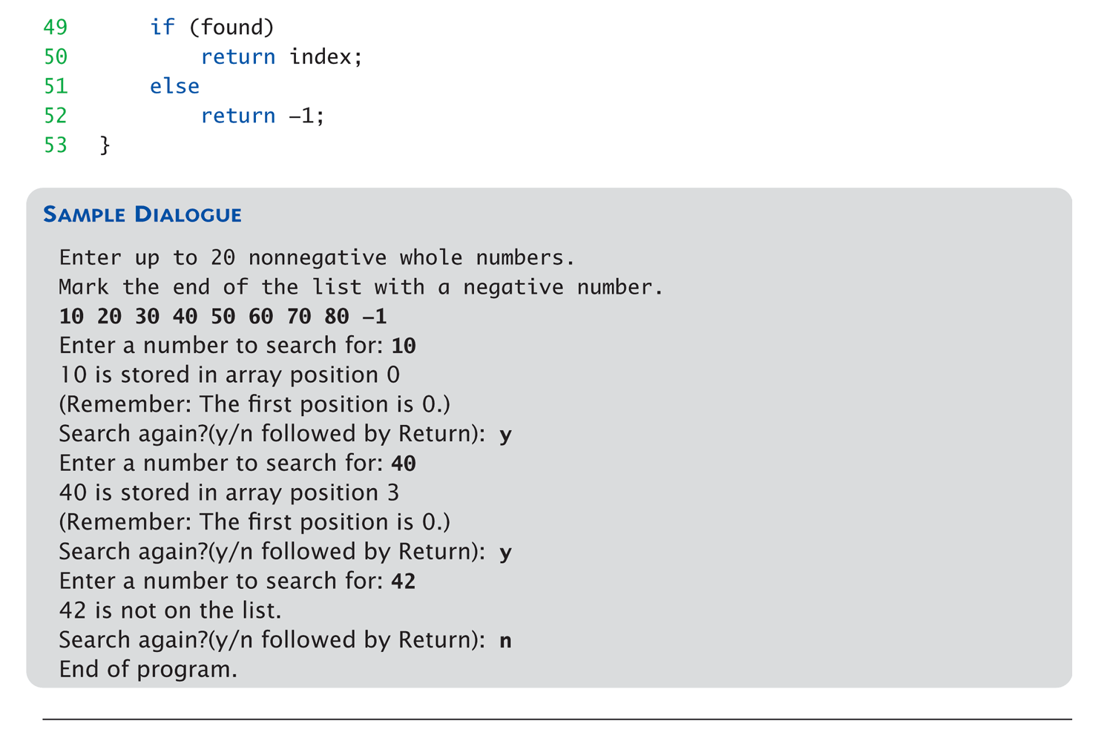
Searching an Array (4 of 4)

Slide 27
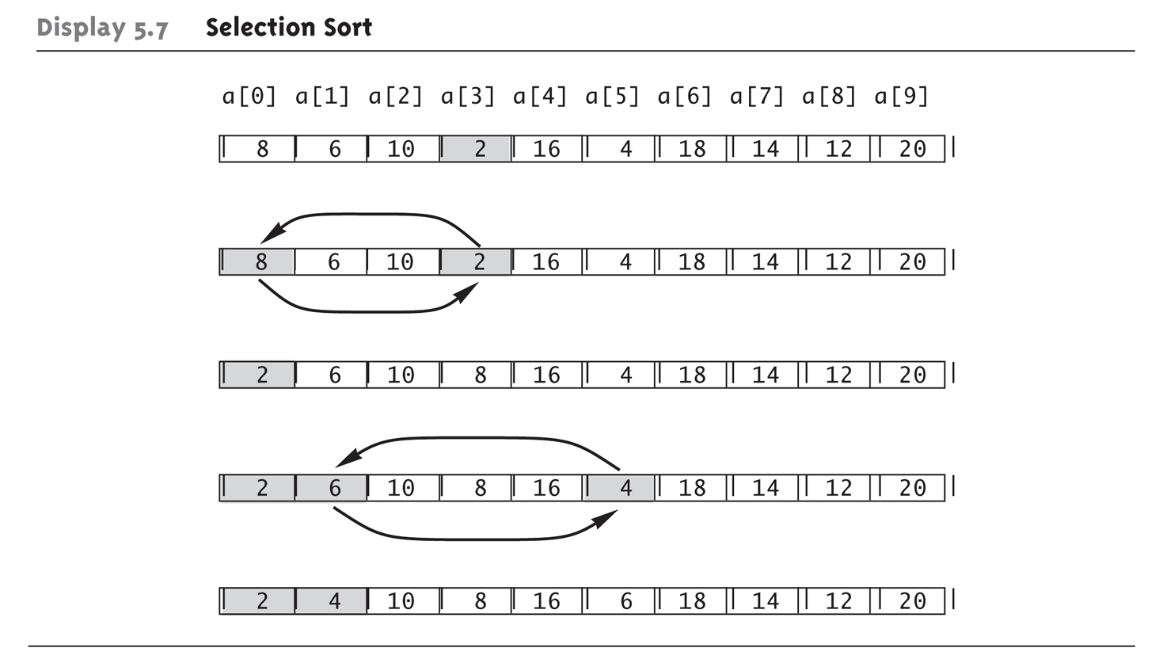
Sorting an Array Selection Sort Algorithm
Find the smallest value in the array.
Swap with first element
Move to next element, find smallest value in remainder

Slide 28
Selection Sort PseudoCode
For (int i=0; i< size-1; i++)
min = a[i];
minIdx = i;
for (int j = i+1; j < size; j++)
if (a[j] < min)
min = a[j];
minIdx = j;
if (i != minIdx)
temp = a[i];
a[i] = a[minIdx]
a[minIdx] = temp;
Go through the remaining array and find the smallest value

Slide 29
Learning Objectives
Complex Data – Intro to Arrays
More Details on Debugging and Testing programs
Multidimensional Arrays.

Slide 30
Testing and Debugging Options Methods
Lots of cout statements
In calls and definitions
Used to "trace" execution
Compiler Debugger
Environment-dependent
assert Macro
Early termination as needed
Stubs and drivers
Incremental development

Slide 31
Fundamental Testing Rule
Start small – test incrementally
Easier to write "correct" programs
Minimize errors, "bugs"
Ensure validity of data
Test every function in a program where every other function has already been fully tested and debugged
Avoid "error-cascading" & conflicting results

Slide 32
Stubs and Drivers
Separate compilation units
Each function designed, coded, tested separately
Ensures validity of each unit
Divide & Conquer
Transforms one big task → smaller, manageable tasks
But how to test independently?
Driver programs

Slide 33
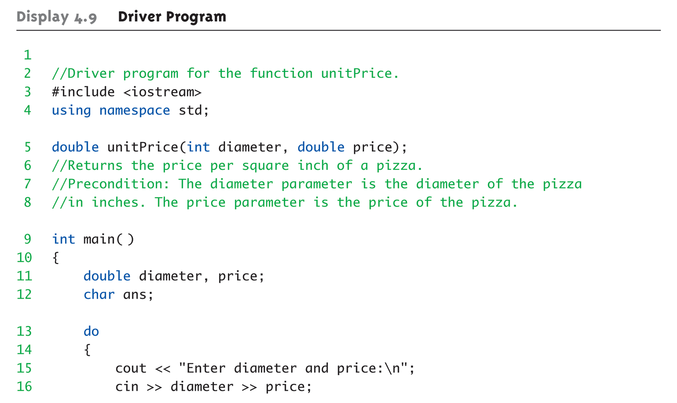
Driver Program Example: 1 of 3

Slide 34
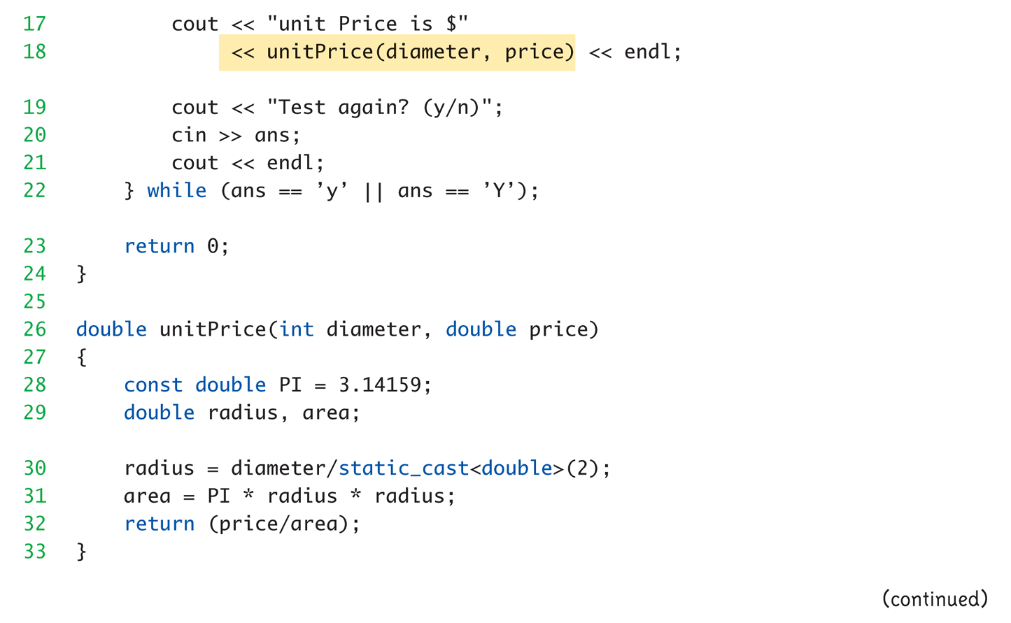
Driver Program Example: 2 of 3

Slide 35
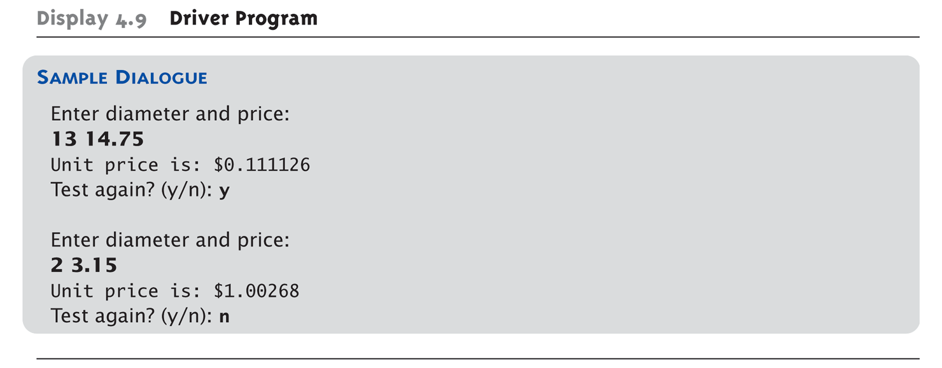
Driver Program Example: 3 of 3

Slide 36
Stubs
Develop incrementally
Write "big-picture" functions first
Low-level functions last
"Stub-out" functions until implementation
Example: double unitPrice(int diameter, double price) { return (9.99); // not valid, but noticeably // a "temporary" value }
Calls to function will still "work"

Slide 37
IDE Debugging Visual Studio, Eclipse, even IE 9!
Review Code Step by Step During Execution
Set Breakpoints
Force code to stop at an instruction
Repeat loops and stop at each iteration
Stop at entry to functions
Watch Variables
View variable contents change
Stop at certain values.

Slide 38
Visual Studio Debugging Practice
Open Lab 5 Solution from Sakai
Resources → Lab Solutions → Lab 5 Soln.cpp
Select all code and copy
Create a new VisualStudio project
Call it Lab5Debug
Add new item and paste the code from previous step
Build the project as you normally would
Run and choose option 1 to calculate inflation rate

Slide 39


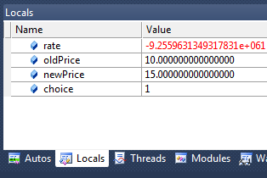


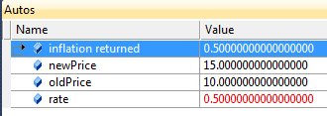
Visual Studio Debugging Practice
Verify that the environment is set to debug
Click in grey area next to the call to inflation function. Press Play Button
Check out the local variable values
Debug Toolbar : Play, Stop, Step Into, Step Over
The Yellow arrow indicates current line TO BE executed. Press Step Over (F10)
Notice rate change

Slide 40
Debugging More Practice
Repeat execution, but use Step Into (F11)
View the call stack in lower right. This tells you which line is calling the function
Right click on breakpoint at call to inflation.
Choose Condition
Set the condition test to be oldPrice == 10.5
Press Play
Change variable value
Pick upper range variable in the locals area.
Type in new value
Hover over the local variables
You can see current value
Pin the variable to the display
Click on the watch tab. Drag variable to the Name field

Slide 41
Learning Objectives
Complex Data – Intro to Arrays
More Details on Debugging and Testing programs
Multidimensional Arrays.

Slide 42
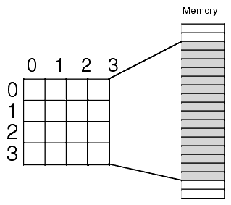
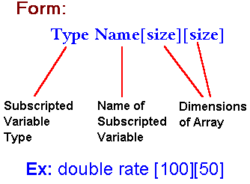

Multidimensional Array
Notes:
Arrays with more than one index
char page[30][100];
Two indexes: An "array of arrays"
Visualize as: page[0][0], page[0][1], …, page[0][99] page[1][0], page[1][1], …, page[1][99] … page[29][0], page[29][1], …, page[29][99]
C++ allows any number of indexes
Typically no more than two

Slide 43
Working with Multi Dimensions
Initialization
int matrix[2][5] = { {1,2,3,4,5}, {6,7,8,9,10}};
Assignment
2D : matrix[i][j] = 5;
3D : space[x][y][z] = 3.1415;
Loops
Nested loops are natural to work with multiple dimension loops
for (int i=0; i< row; i++)
For (int j=0; j < col, j++)
matrix[i][j] = 5;

Slide 44
2-D Array Practice
Define a 3x3 array of integers.
Initialize values
Write for loops to sum all of the rows
Display the row total for each row
Write for loops to sum all of the columns
Display the column total for each column

Slide 45
Multidimensional Array Parameters
Similar to one-dimensional array
1st dimension size not given - Provided as second parameter
2nd dimension size IS given
Example: void DisplayPage(const char p[][100], int sizeDimension1) { for (int index1=0; index1<sizeDimension1; index1++) { for (int index2=0; index2 < 100; index2++) cout << p[index1][index2]; cout << endl; } }

Slide 46
2-D Array Function Practice
Move the code in the previous practice to a function
Function should receive the input array, and output the row sums and column sums as target single dimension arrays.
Function can be void.
Remove the print statements from the loops

Slide 47
More 2-D Array Practice (if time)
Write a function that will find the minimum (or maximum) value in a 2-D array.
Input parameters are the array and flag on whether to search for min or max.

Slide 48
Key Takeaways
Debugging
Start small
Driver programs vs _________ functions
Visual Debugger
Arrays
Used for searches, sorting, and storing similar data types
Arrays and functions – use Pass By _________
Programmer is responsible for array bounds

